Slide 1
The Benefits of
Neuro Physical Therapy
Melody Bandley

Slide 2
PT vs. Neuro PT
Physical Therapy
Addresses movement issues due to injury or disease affecting part of the body.
Example: Sprained ankle
Neurologic Physical Therapy
Addresses movement issues due to injury or disease affecting the brain/nervous system.
Example: Huntington’s Disease

Slide 3
Goals of Neuro PT
Improve movement and function
Optimize independence and safety
Individualized application of objectives
Tailor the program to meet each person’s needs

Slide 4
Tips for Success
Motivation to exercise is very individual, find what works
Be specific - avoid generalities when setting goals
Work on the highest priorities to avoid getting overwhelmed
Plan for small successes to help increase motivation
Don’t be discouraged by resistance to exercise. Slowly introduce new exercises and be patient as a new routine is established.
Repetition is the key to success

Slide 5
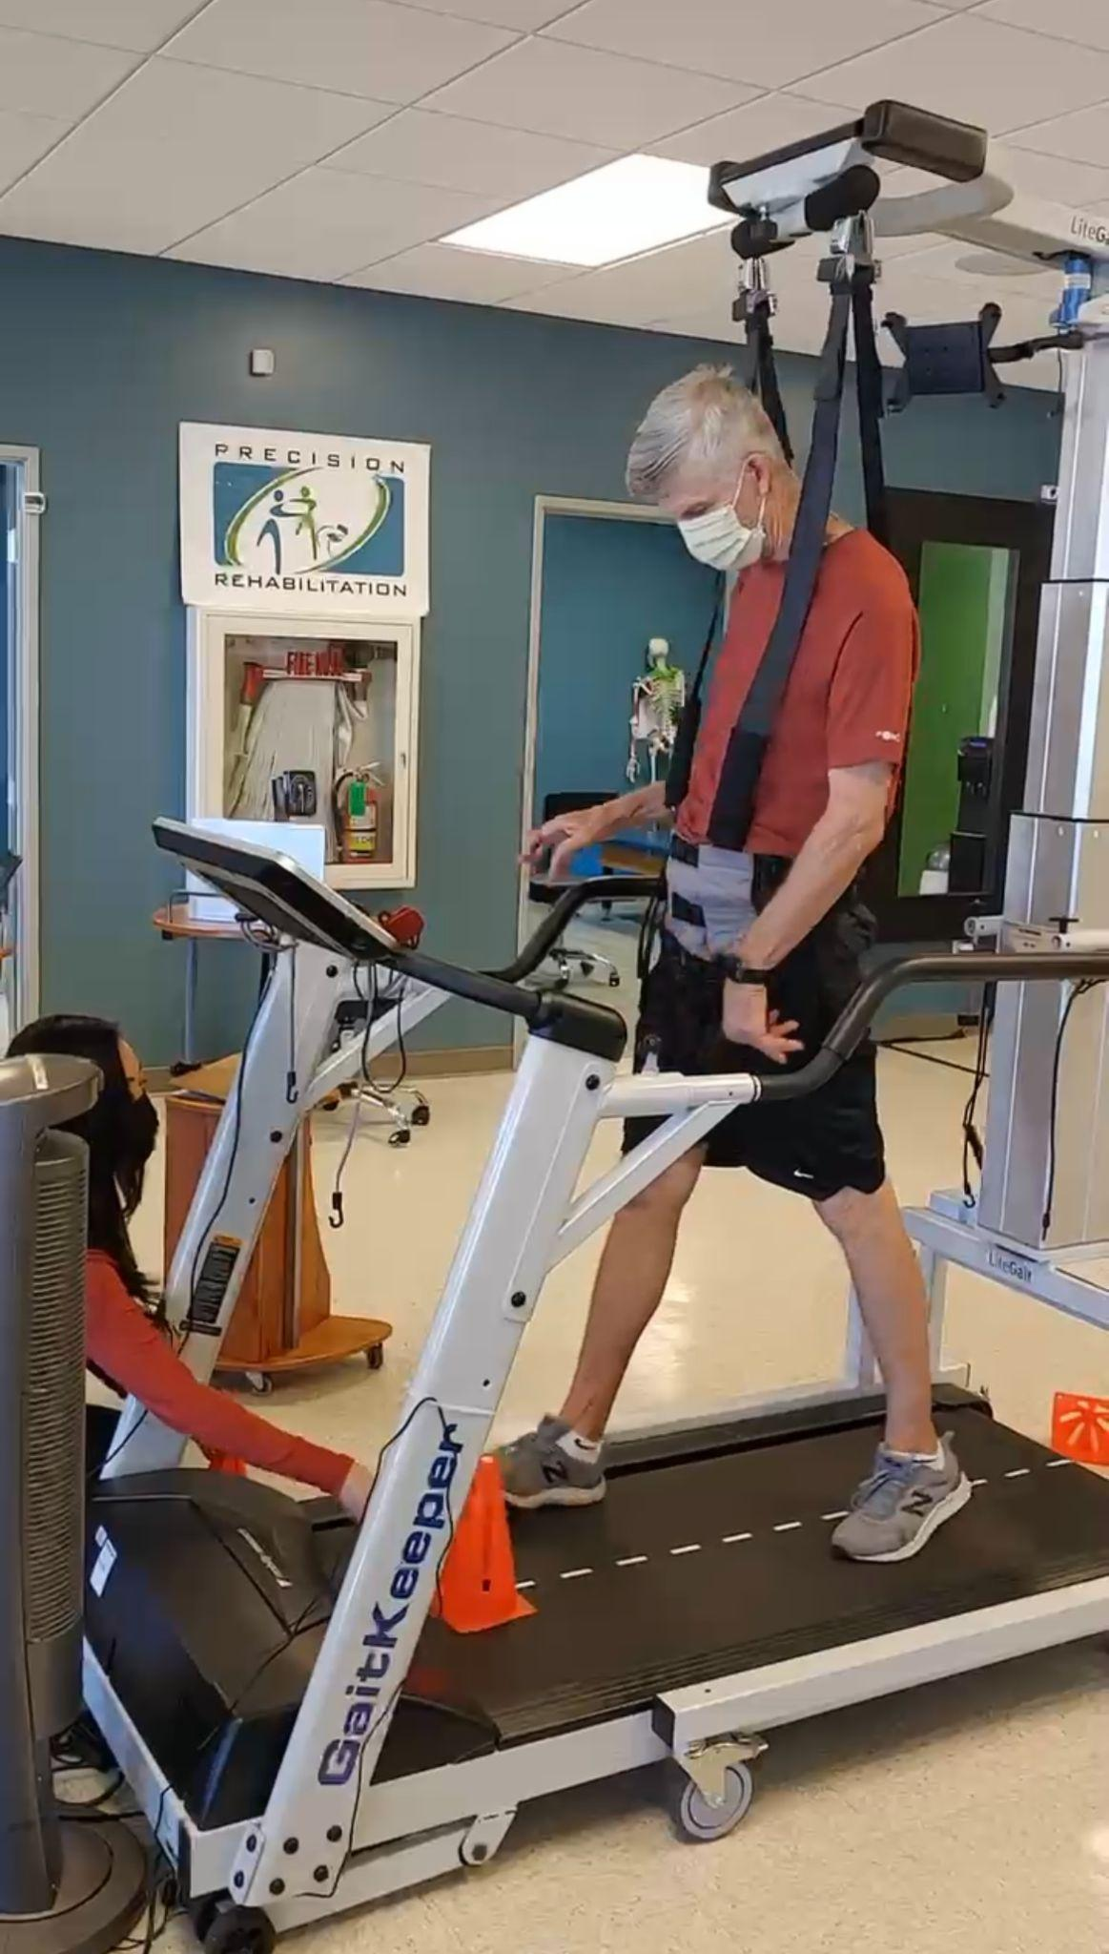
Our Experience
Our goals are to improve walking and balance
Safety equipment and therapist support make “risky” training possible
Cannot improve without “pushing the envelope”

Slide 6
Variety in moderation
Balance love of routine with variety to keep progressing and maintain interest
Address the same problem in multiple ways
Example
Improve balance by:
Improving core strength
Addressing muscle imbalance
Practicing walking and standing on various uneven surfaces

Slide 7
Examples of Helpful Balance Exercises

Slide 8
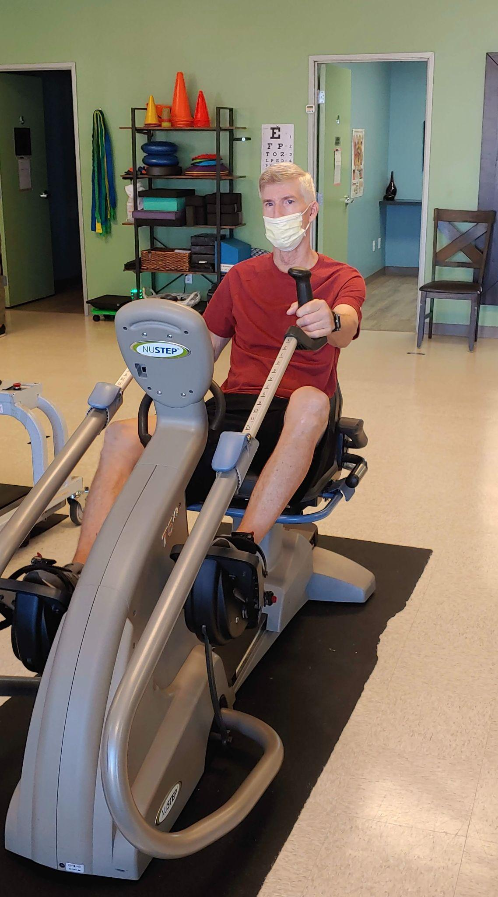
Helpful Equipment
Aerobic Exercise is especially difficult for HD patients, but it is important as it helps improve strength and coordination, boosts mood and concentration, and also fights fatigue.
A recumbent stepper is an excellent way for people with HD to get aerobic exercise safely.

Slide 9
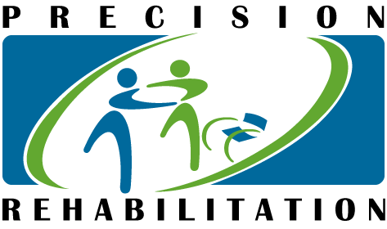
What I’ve seen…
Therapists elicit better effort and notice/address subtle issues.
Everything improves with practice.
The biggest obstacle is motivation.
PT is helping maintain and improve ability to function.
Kimberly Yoshinaga, PT, DPT
Precision Rehabilitation
3294 E. Spring St. Long Beach, CA 90806
(562) 988-3570

